Slide 1












O-505 - FLAIR Fusion in Multiple Sclerosis follow up : an unavoidable tool in Private Practice
CLINIQUE DU MAIL
GRENOBLE, FRANCE
E Lamain, O Casez, M Vaillant, V Lefournier, P Tourret, M Bakir, P Roux, J Savatovsky, S Cantin
Dr CANTIN Stéphane
Groupe Clinique du Mail – Grenoble – FRANCE
stephane.cantin@groupe-du-mail.com

Slide 2

Conflict of interest
No conflict of interest

Slide 3
Purpose : improving Multiple sclerosis follow up
Multiple sclerosis : millions of MRI scans around the world
Treatment efficacy : MAGNIMS 2016 criteria for the dissemination in time assessment

Slide 4
Purpose : improving Multiple Sclerosis Follow up
Dissemination in time assessment :
  1- Frame by frame (FBF) FLAIR comparison
    - time consuming, depending of the lesion load
  2- FLAIR Subtraction
    - Only between sequences intra exam?
    - Software ? : cost, time for exportation?
  3- FLAIR Fusion (included in Post treatment package)

Slide 5
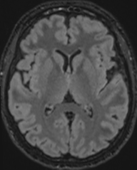
Materials and Methods
Post treatment using Siemens Syngovia software
  Coregistration and fusion
  Application of a colored clut
+
=
OLD
NEW
FUSION
+
=

Slide 6
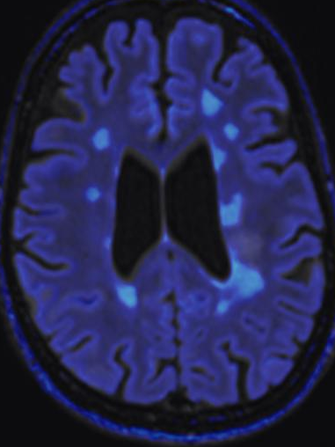
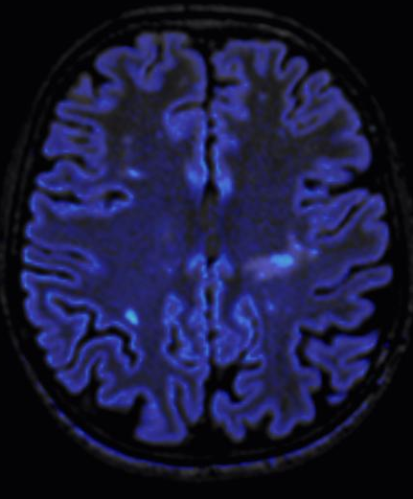
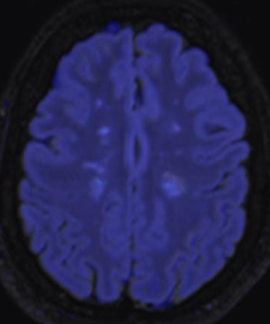
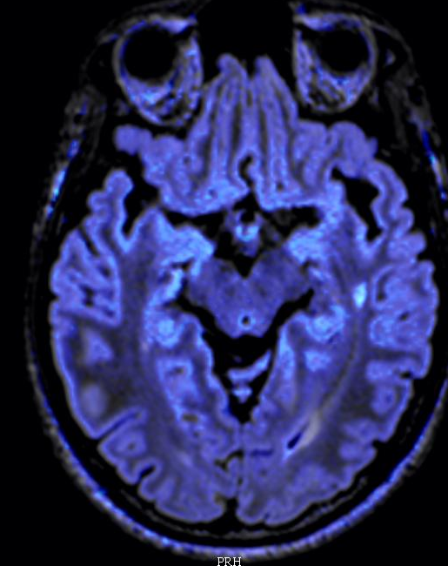
Lesion type :
Periventricular/deep WM

Slide 7
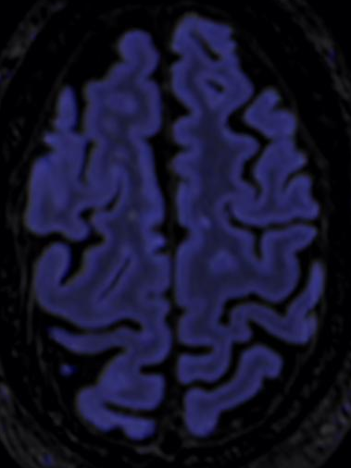
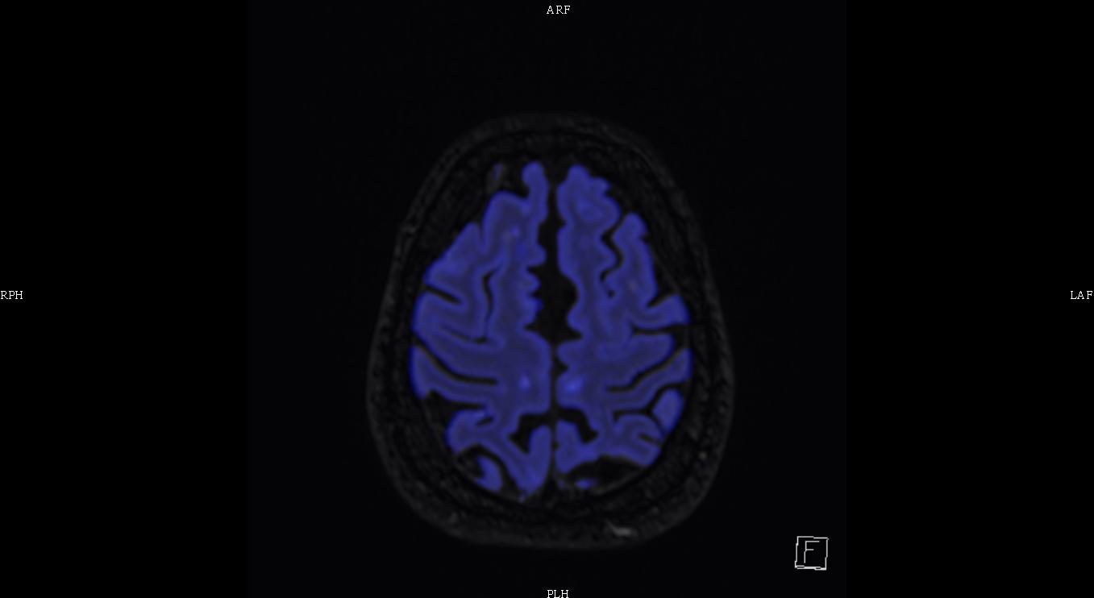
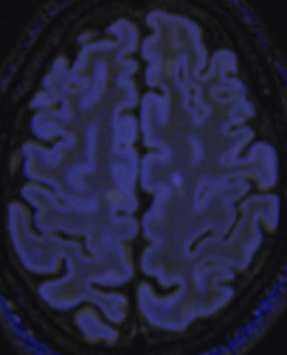
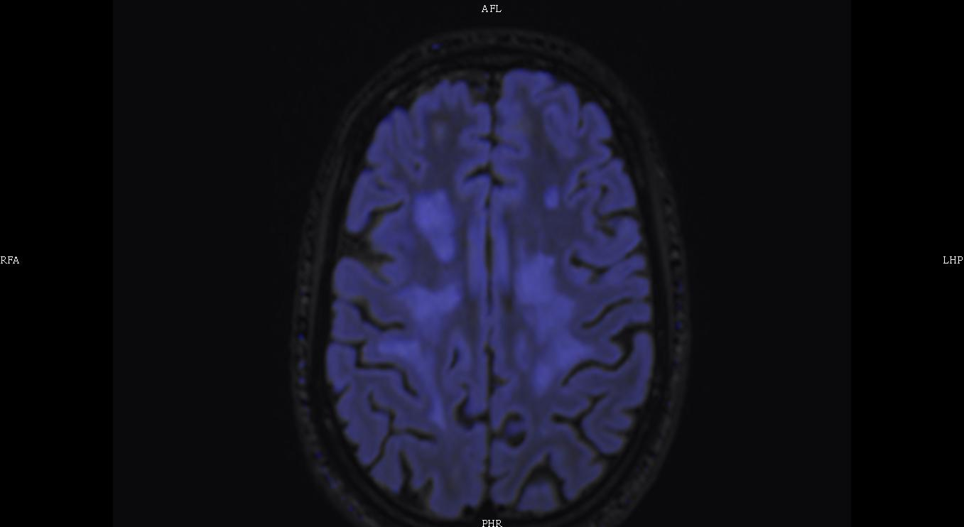
Lesion type : subcortical / cortical

Slide 8
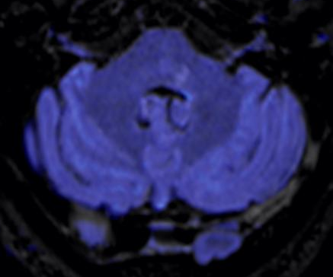
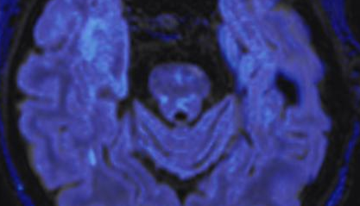
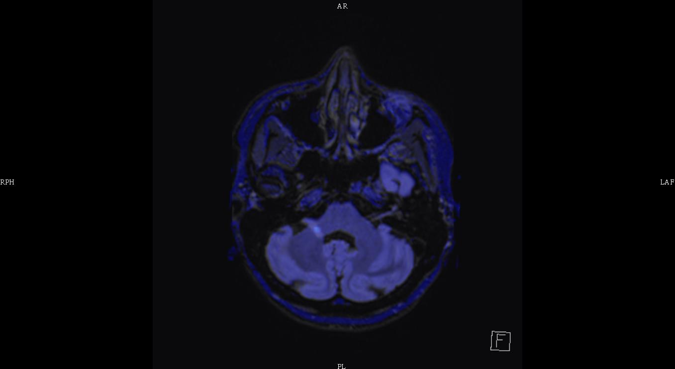
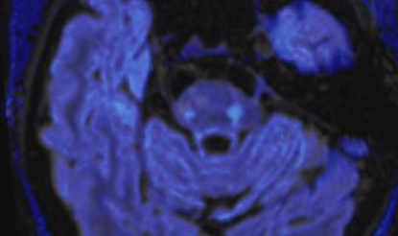
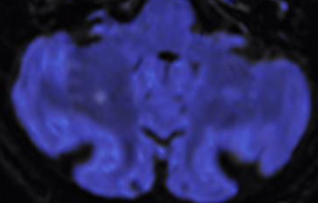
Lesion type :
Posterior fossa

Slide 9
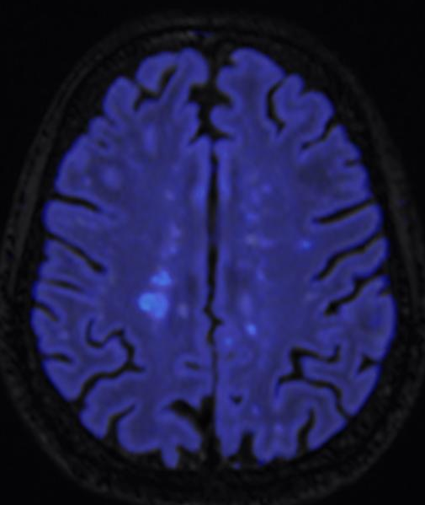
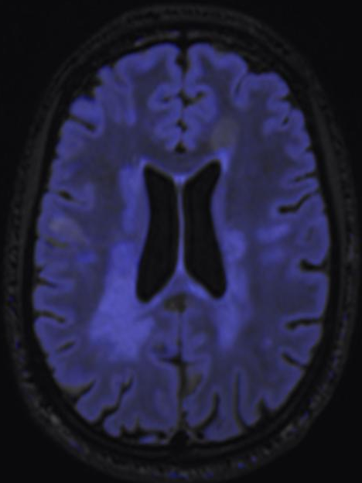
Lesion type :
High lesion load

Slide 10
Materials and Methods
Retrospective blinded study
21 patients
2 readers : 1 neuroradiologist, 1 radiology technician
  Number of new MS lesions
  Interpretation time
  Evolution of the agreement between readers

Slide 11
Results
Interpretation time (seconds): Mann-Whitney U Test
Technician
Neuroradiologist
Time saving : 59%
Z score : -1,77348
p=0,07
Non significant
Z score : -4,8299
p=1,35 10⁻⁶
Significant

Slide 12
Results
Number of new MS lesions : Mann-Whitney U Test
Technician
Neuroradiologist
Z score : -1,7609
p=0,0784
Non significant
Z score : 1,45903
p=0,1443
Non significant

Slide 13
Results
Agreement between readers : Number of lesions
FBF
FUSION
Spearman’s rho : 0,6255 p=0,0024
Kendall’s tau: 0,5566 p=0,0022
Spearman’s rho : 0,8305 p=3,2 10⁻⁶
Kendall’s tau: 0,7377 p=1,52 10⁻⁵

Slide 14
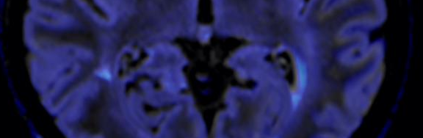
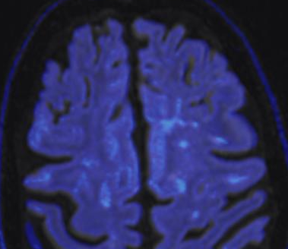
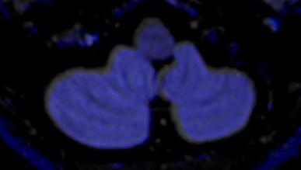
Limits
Patient number
Technical limits (imperfect coregistration), learning curve

Slide 15
Conclusion
Easy to implement
Cost effective
Provides :
  Faster analysis
  AND/OR
  Probably increases the number
  of new lesions detected

Slide 16
Bibliography
1-Horsfield MA et al. Estimating Brain Lesion Volume Change in Multiple Sclerosis by Subtraction of Magnetic Resonance Images. J Neuroimaging. 2016 ; 26 : 395-402.
2-Moraal B et al. Subtraction MR images in a multiple sclerosis multicenter clinical trial setting. Radiology. 2009 ; 250 : 506-14.
3- Leng Tan I et al. Serial Isotropic Three-Dimensional
Fast FLAIR Imaging: Using Image Registration and Subtraction to Reveal Active Multiple Sclerosis. Lesions, AJR. 2002 ; 179 : 777-82
4-Duan Y et al. Segmentation of Subtraction Images for the Measurement of Lesion Change in Multiple
Sclerosis, AJNR. 2008 ; 29 : 340-46
5- Moraal B et al. Improved Detection of Active Multiple Sclerosis Lesions : 3D Subtraction Imaging, Radiology 2010 ; 255 : 154-163
6- Ganiler O et al. A subtraction pipeline for automatic detection of new appearing
multiple sclerosis lesions in longitudinal studies, Neuroradiology 2014 ; 56 : 363–374
7-Leng Tan I et al. Image registration and subtraction to detect active T2 lesions in MS:
an interobserver study, J Neurol 2002 ; 249 : 767–773

Slide 17


THANK YOU

